Slide 1
View from Lab Management
Bob McKeown
HPS Collaboration Meeting
May 26, 2011

Slide 2
Funding Outlook
FY11 CR for Balance of Year
Strong support from DOE NP
12 GeV funding at full $36M level
Ran full operations through mid May
6 month shutdown - coordinated project May 13
Balance of G2P funding received
FY12 President’s Budget and Prospects
OK for Jefferson Lab operations
Full support for 12 GeV Upgrade
Increase in Nuclear Physics is all construction (12 GeV, FRIB)
Discussions with DOE-NP
Future operations budgets(FY16+)
Future MIE Projects (SBS, Moller, Solid +)

Slide 3
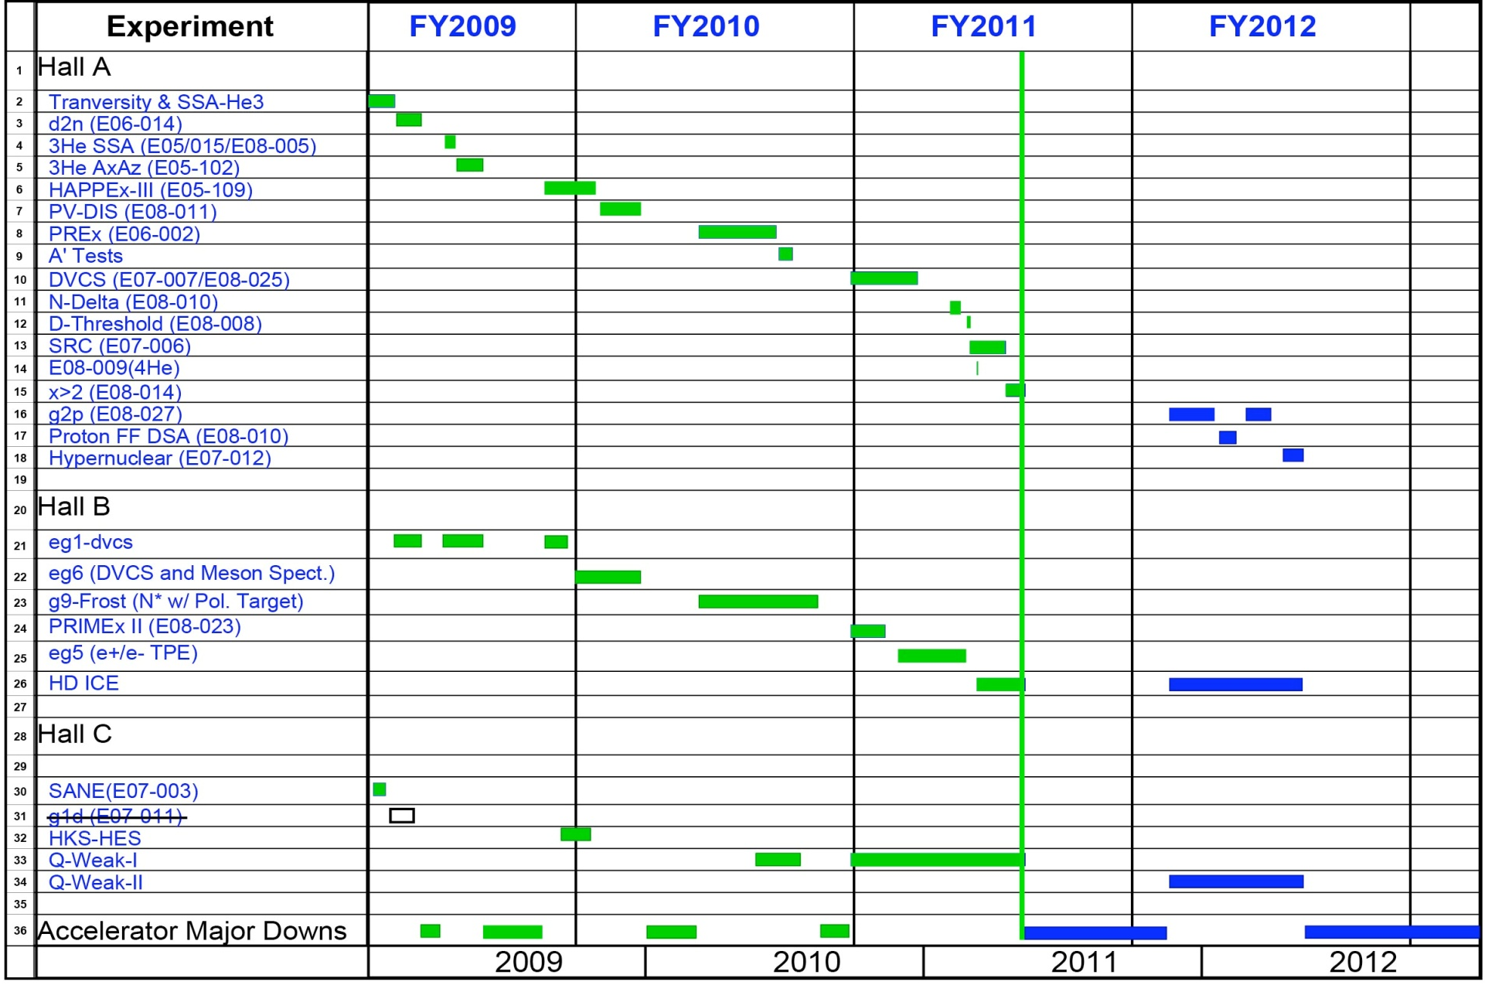
Experimental Nuclear Physics Program
X

Slide 4
6 GeV Program Status
Hall A - g₂^{p}
- installation proceeding
- funding received
Hall B - HDice
- good progres but suffered stuck needle valve in May – did not get to take beam
- plan to be ready for beam in November
Hall C
- Qweak obtained >25% of production data
- reliability improvements during 6 mo. down

Slide 5
12 GeV Upgrade Project
Upgrade is designed to build on existing facility: vast majority of accelerator and experimental equipment have continued use
New Hall
Add 5 cryomodules
Upgrade arc magnets
and supplies
CHL upgrade
Maintain capability to deliver lower pass beam energies:
2.2, 4.4, 6.6….
20 cryomodules
Add arc
20 cryomodules
Add 5 cryomodules
Scope of the project includes:
Doubling the accelerator beam energy
New experimental Hall and beamline
Upgrades to existing Experimental Halls
Enhanced capabilities
in existing Halls

Slide 6
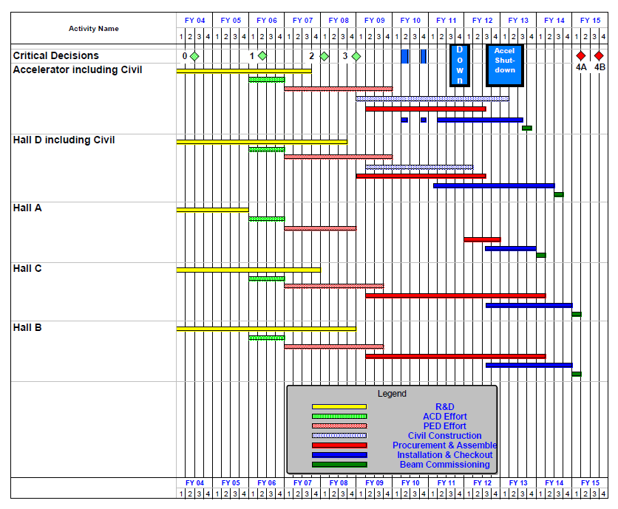
12 GeV Upgrade Schedule
Two short parasitic installation
periods in FY10
6-month installation
May – Oct 2011
12-month installation
May 2012 – May 2013
Hall A commissioning start
October 2013
Hall D commissioning start
April 2014
Halls B/C commissioning start
October 2014
Project Completion
June 2015

Slide 7
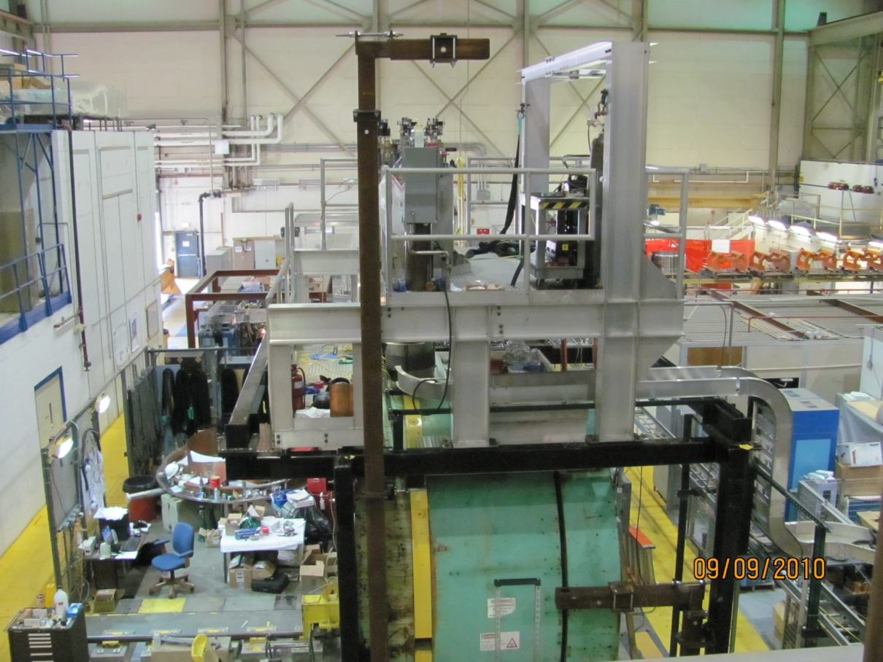
Hall D Solenoid Test
Coil 1 test at 1200A 
Coil 4 test at 1500A 
Coil 3 test at 1500A 

Slide 8
PAC 12 GeV Science Categories
The Hadron spectra as probes of QCD (GlueX and heavy baryon and meson spectroscopy)
The transverse structure of the hadrons (Elastic and transition Form Factors)
The longitudinal structure of the hadrons (Unpolarized and polarized parton distribution functions)
The 3D structure of the hadrons (Generalized Parton Distributions and Transverse Momentum Distributions)
Hadrons and cold nuclear matter (Medium modification of the nucleons, quark hadronization, N-N correlations, hypernuclear spectroscopy, few-body experiments)
Low-energy tests of the Standard Model and Fundamental Symmetries (MOLLER, PVDIS, PRIMEX, …..)

Slide 9
12 GeV Approved Experiments by Physics Topics
 | Topic | Hall A | Hall B | Hall C | Hall D | Total
 | The Hadron spectra as probes of QCD (rated) (GluEx and heavy baryon and meson spectroscopy) |  | 1 |  | 1 | 2
 | The transverse structure of the hadrons (rated) (Elastic and transition Form Factors) | 4 | 2 | 3 |  | 9
 | The longitudinal structure of the hadrons (rated) (Unpolarized and polarized parton distribution functions) | 2 | 2 | 4 |  | 8
 | The 3D structure of the hadrons (unrated) (Generalized Parton Distributions and Transverse Momentum Distributions) | 3 | 8 | 4 |  | 15
 | Hadrons and cold nuclear matter (rated) (Medium modification of the nucleons, quark hadronization, N-N correlations, hypernuclear spectroscopy, few-body experiments) | 1 | 2 | 5 |  | 8
 | Low-energy tests of the Standard Model and Fundamental Symmetries (rated at PAC 37) | 2 |  |  | 1 | 3
 | TOTAL | 12 | 15 | 16 | 2 | 45

Slide 10
 | Topic | Hall A | Hall B | Hall C | Hall D | Total
 | The Hadron spectra as probes of QCD (rated) (GluEx and heavy baryon and meson spectroscopy) |  | 119 | 0 | 120 | 239
 | The transverse structure of the hadrons (rated) (Elastic and transition Form Factors) | 144 | 70 | 168 |  | 382
 | The longitudinal structure of the hadrons (rated) (Unpolarized and polarized parton distribution functions) | 65 | 120 | 118 |  | 303
 | The 3D structure of the hadrons (unrated) (Generalized Parton Distributions and Transverse Momentum Distributions) | 225 | 891 | 134 |  | 1250
 | Hadrons and cold nuclear matter (rated) (Medium modification of the nucleons, quark hadronization, N-N correlations, hypernuclear spectroscopy, few-body experiments) | 5 | 100 | 139 |  | 244
 | Low-energy tests of the Standard Model and Fundamental Symmetries (to be rated at PAC 37) | 513 |  |  | 79 | 592
 | TOTAL | 952 | 1300 | 559 | 199 | 3010
 | Days in red are the requested days to be reviewed at PAC38
12 GeV Approved Experiments by PAC Days

Slide 11
PAC38
Scheduled for week of August 22, 2011
Consider new proposals and letters of intent
Complete “grading” by rating 11 previously approved proposals in the category:
The 3D structure of the hadrons

Slide 12
HPS
Congratulations on test apparatus funding approval!
Address recommendations from DOE review
We should now be sure that we agree on
- construction commitments (check resources)
- construction schedule
Best wishes for a productive meeting

